Slide 1
Illumination Model and Shading
Dr. Sk. Md. Masudul Ahsan
Professor
CSE, KUET
Md Tajmilur Rahman
Lecturer
CSE, KUET
Notes:
Created by: Dr. Sk. Mohammad Masudul Ahsan
& S. M. Taslim Uddin Raju
Edited by:
Md Nazirul Hasan Shawon
Lecturer, CSE, KUET

Slide 2
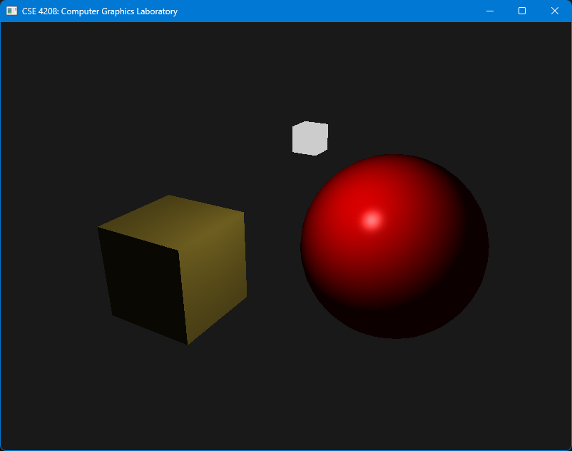
Our today’s work output

Slide 3
What You’ll See Today
Lighting Principles
Illumination Model
Ambient
Diffuse
Specular
Shading

Slide 4
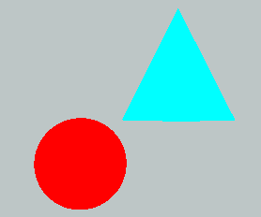
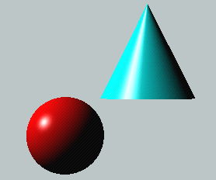
Lighting Principles
Lighting simulates how objects reflect light
material composition of object
light’s color and position
global lighting parameters
ambient light
two sided lighting

Slide 5

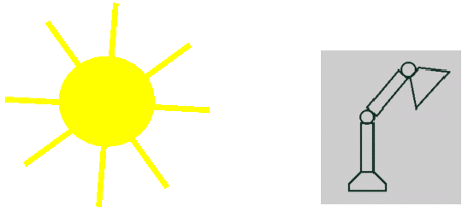
Light Source Model
Simple Mathematical Models:
Point light
Directional light
Spot light

Slide 6
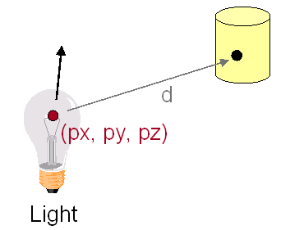
Point Light Source
Models Omni-Directional Point Source (E.g., Bulb)
Intensity (I₀)
Position (px, py, pz)
Factors (k_{c}, k_{l}, k_{q}) for attenuation with distance (d)

Slide 7
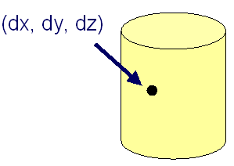
Directional Light Source
Models Point Light Source at Infinity (E.g., Sun)
Intensity (I₀)
Direction (dx,dy,dz)
No attenuation
with distance

Slide 8
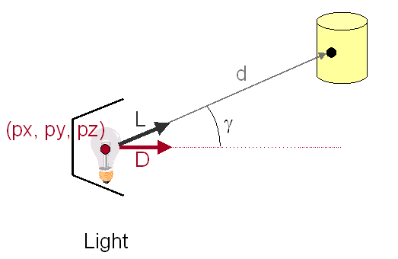
Spot Light Source
Models Point Light Source with Direction (E.g., Luxo)
Intensity (I₀)
Position (px, py, pz)
Direction (dx, dy, dz)
Attenuation

Slide 9
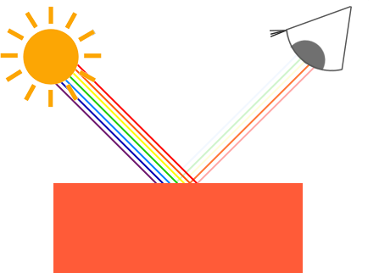
Lighting Principles (contd.)
How we see an object

Slide 10
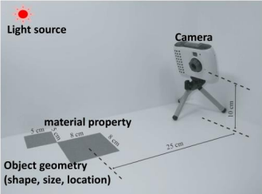
Illumination Model
How to compute color to represent a scene
As in taking a photo in real life:
Camera
Light
Object
Geometry
Material
Illumination model:
Combine all to produce a color Light source

Slide 11
Illumination Model
An object is illuminated from ambient light and from interrelated light source.
The important components are:
Ambient Light
Diffuse Refection
Specular Reflection
Illumination = Ambient Reflection + Diffuse Reflection + Specular Reflection + Emissive Light

Slide 12
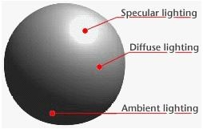
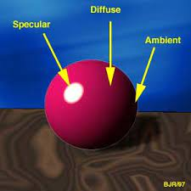
At a glance

Slide 13
Ambient Light
Also called background light
General level of illumination that does not come directly from a light source
Consists of light that has been reflected and re-reflected so many times
When ambient light strikes a surface, it's scattered equally in all directions.
Its direction is impossible to determine

Slide 14
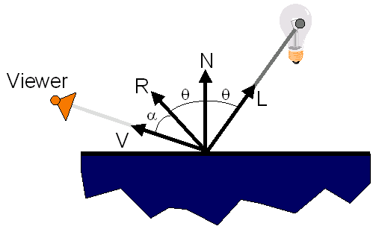
Surface Illumination Calculation
Single Light Source:

Slide 15
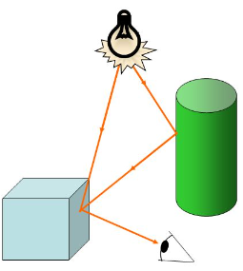

Ambient Light
Light from environment
Light reflected or scattered from other objects
Coming uniformly from all directions and then reflected equally to all directions.
$I_{A}=K_{A} I_{AL}$

Slide 16
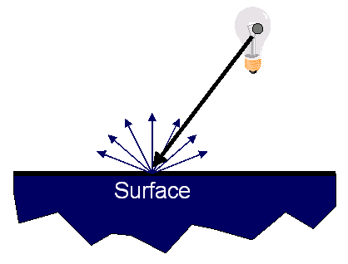
Diffuse Reflection
Light that comes from one direction
Light scattered with equal intensity in all directions (ideal diffuse reflection)

Slide 17
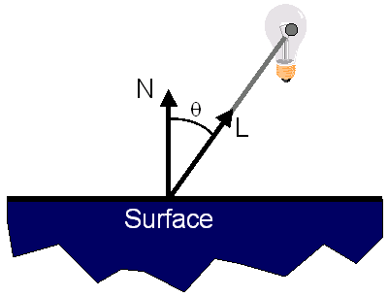
Diffuse Reflection
How Much Light is Reflected?
Depends on angle of incident light

Slide 18
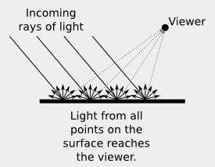
Diffuse Reflection
Light from a point is independent on viewing direction (equally bright in all directions)
Once it hits a surface, however, it's scattered equally in all directions, so it appears equally bright, no matter where the eye is located.

Slide 19
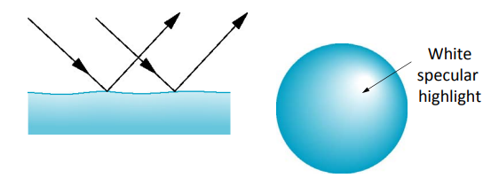
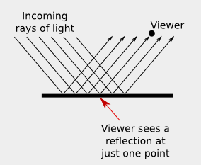
Specular Reflection
Light comes from a particular direction, and it tends to bounce off the surface in a preferred direction.
Depends on angle of incident light and angle to viewer
Intensity depends on where the viewer is!

Slide 20
Specular Reflection
How Much Light is Reflected?
Depends on angle of incident light and angle to viewer

Slide 21
Gourad Surface Rendering
N₂
The average unit normal vector at V is given as:
or more generally:
N_{V}
N₁
N₃
N₄
V

Slide 22
Gouraud Surface Rendering (contd.)
Illumination values are linearly interpolated across each scan-line
y
3
1
Scan-line
4
p
5
2
x

Slide 23
Gouraud Surface Rendering (cont…)
An Example
Vertex 1
I = 0.2
0.35
0.50
0.65
Vertex 2
I =0.8
0.3
0.85
0.4
0.9
0.5
0.95
I = 0.6
Vertex 4
I = 1.0
Vertex 3

Slide 24
Phong Surface Rendering
N₃
N₁
N₄
N_{p}
Scan line
p
N₅
N₂

Slide 25
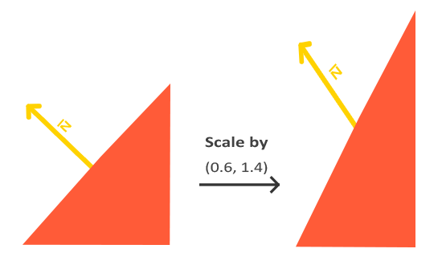
Additional: Transforming Normals

Slide 26
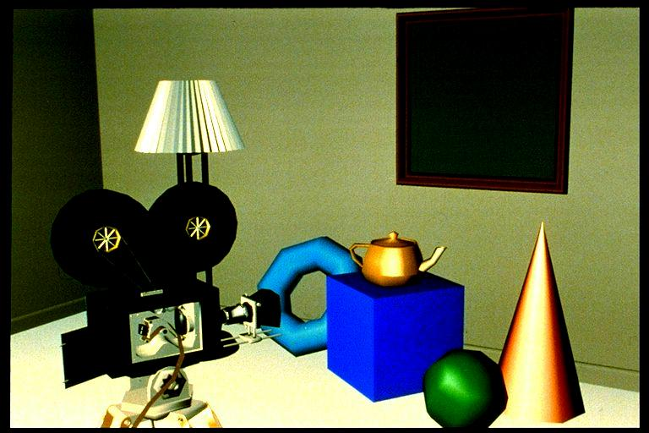
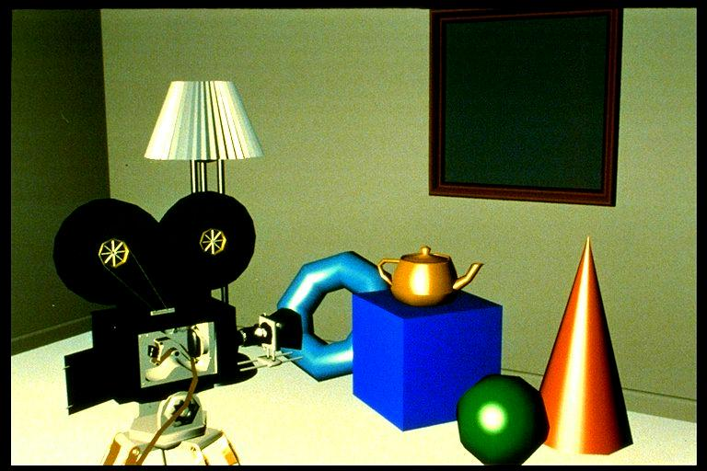
Gouraud Vs Phong Surface Rendering
Gouraud Surface Rendering
Phong Surface Rendering

Slide 27
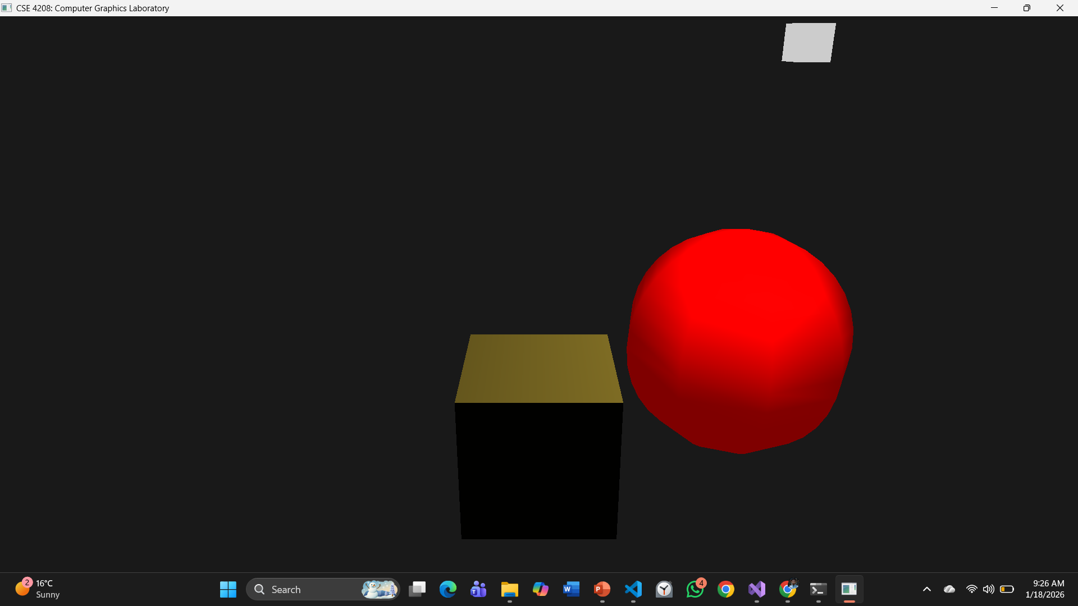
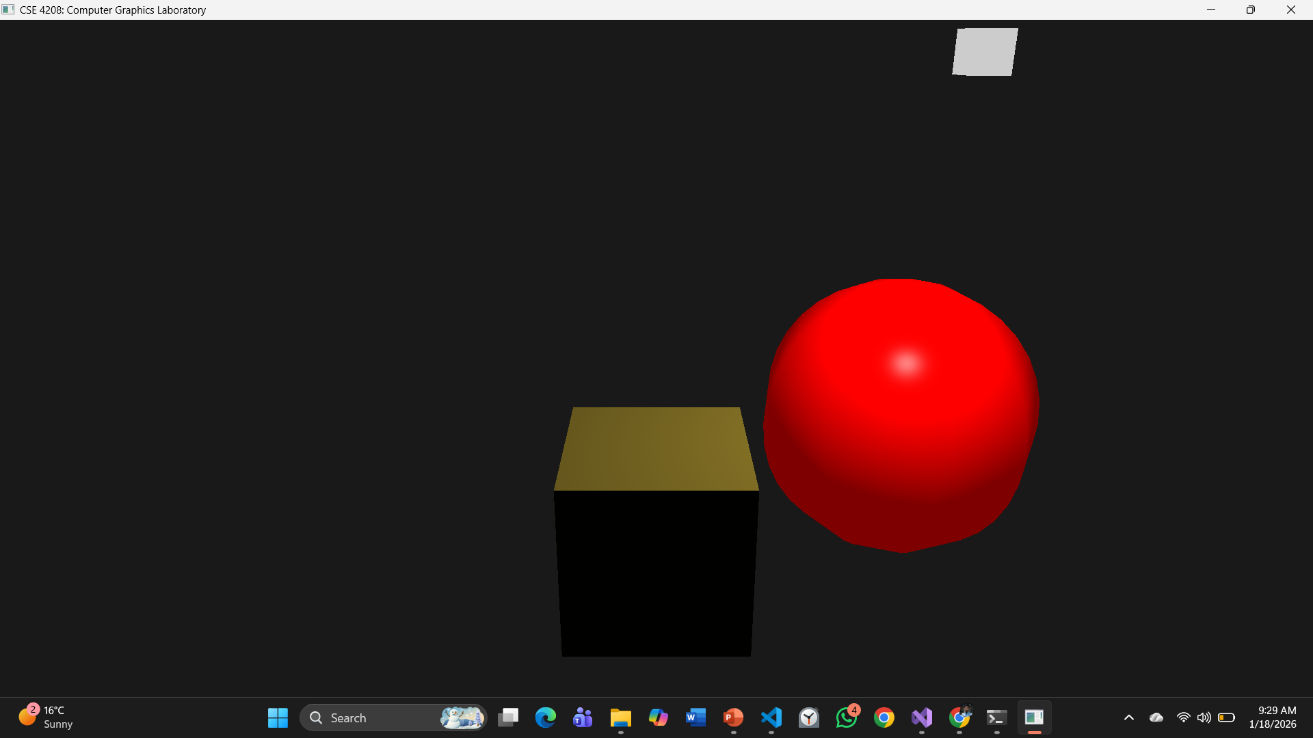


Gouraud Shading Phong Shading
Sector = 9
Sector = 36

Slide 28
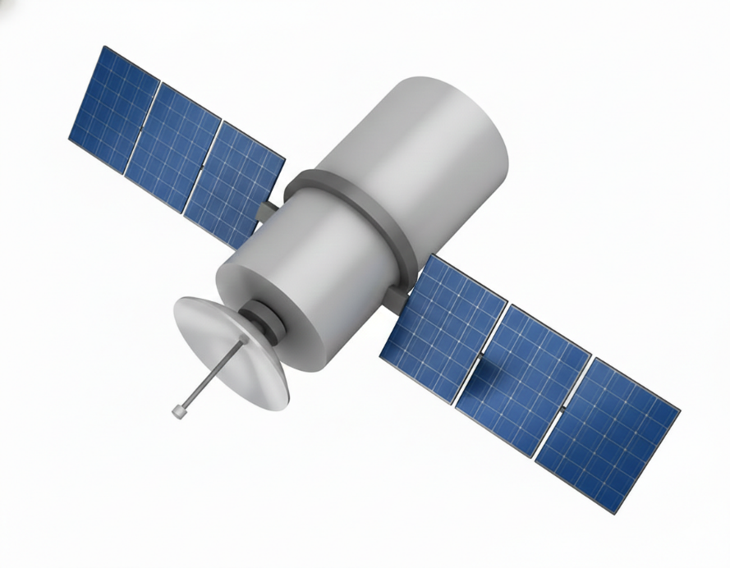
B2
Make a 3D satellite with 3 pivot points
The solar panels and the body are cubic shaped.
Whole body can move in any direction
The solar panels can rotate back and forth like fold and unfold
The antenna can be tilt ups and downs centering pivot point 3
All the transformations are controllable by keyboard.
2
3
1

Slide 29
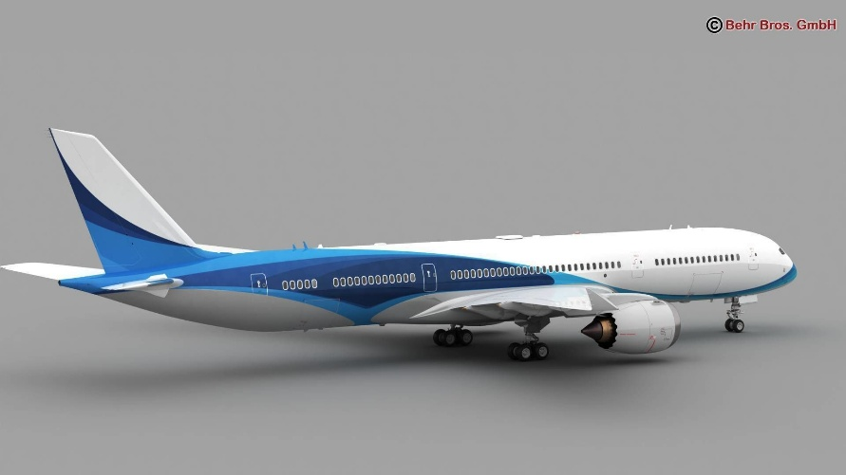
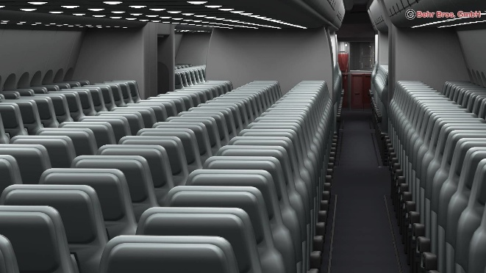
Assignment B1
Implement lighting on your previous assignment or project.
Your scene should have multiple point lights, directional light, spot light (with single cut-off angle)and emissive light.
Use keys 1 to turn on and off directional light, 2 for point lights , 3 for spot light respectively.
Use keys 5, 6 and 7 to turn on and off ambient light, diffuse light and specular light respectively.
Implement your own version of glm:: projection function.
Divide the viewport in 4 equal parts and control the scene of each viewport with input user input. For example:
Print the controls and key actions on console.
Combine Lighting | Ambient Only
Diffusive Only | Directional Only
Isometric View | Top View
Front View | Inside View

Slide 30
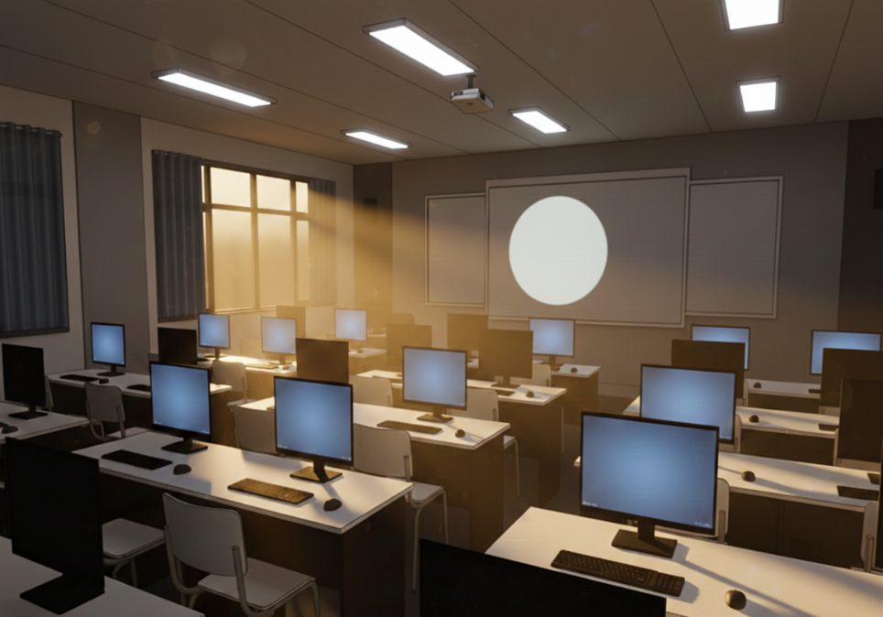
Assignment A1
Implement lighting on your previous assignment or project.
Your scene should have multiple point lights, directional light, spot light (with single cut-off angle)and emissive light.
Use keys 1 to turn on and off directional light, 2 for point lights , 3 for spot light respectively.
Use keys 5, 6 and 7 to turn on and off ambient light, diffuse light and specular light respectively.
Implement your own version of glm:: projection function.
Divide the viewport in 4 equal parts and control the scene of each viewport with input user input. For example:
Print the controls and key actions on console.
Combine Lighting | Ambient Only
Diffusive Only | Directional Only
Isometric View | Top View
Front View | Inside View

Slide 31
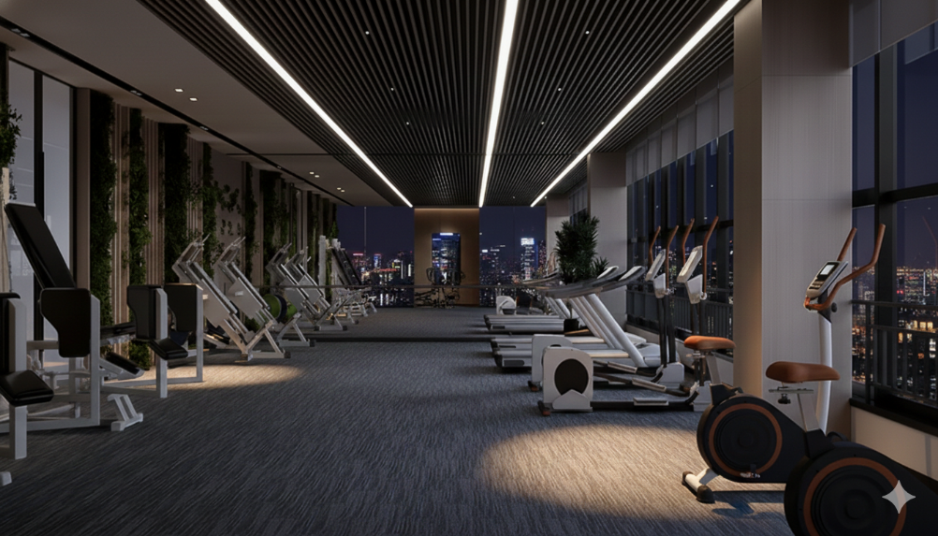
Assignment A2
Implement lighting on your previous assignment or project.
Your scene should have multiple point lights, directional light, spot light (with single cut-off angle)and emissive light.
Use keys 1 to turn on and off directional light, 2 for point lights , 3 for spot light respectively.
Use keys 5, 6 and 7 to turn on and off ambient light, diffuse light and specular light respectively.
Implement your own version of glm:: rotate function.
Divide the viewport in 4 equal parts and control the scene of each viewport with input user input. For example:
Print the controls and key actions on console.
Combine Lighting | Ambient Only
Diffusive Only | Directional Only
Isometric View | Top View
Front View | Inside View

Slide 32
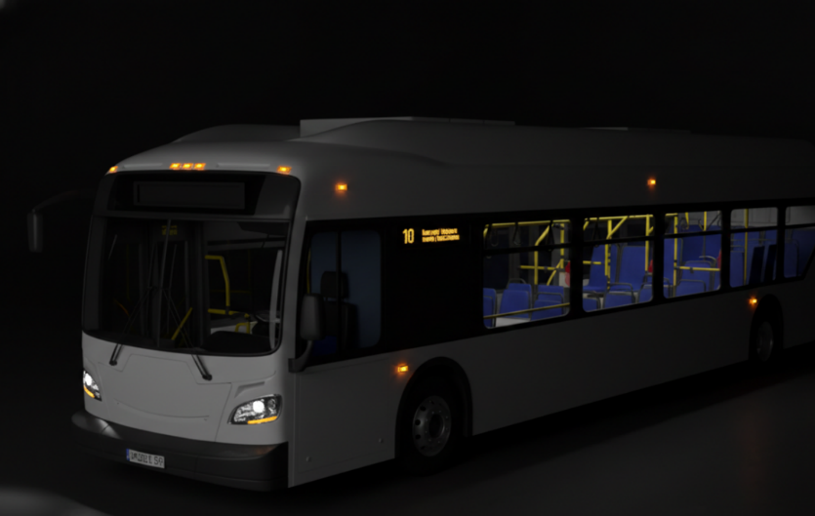
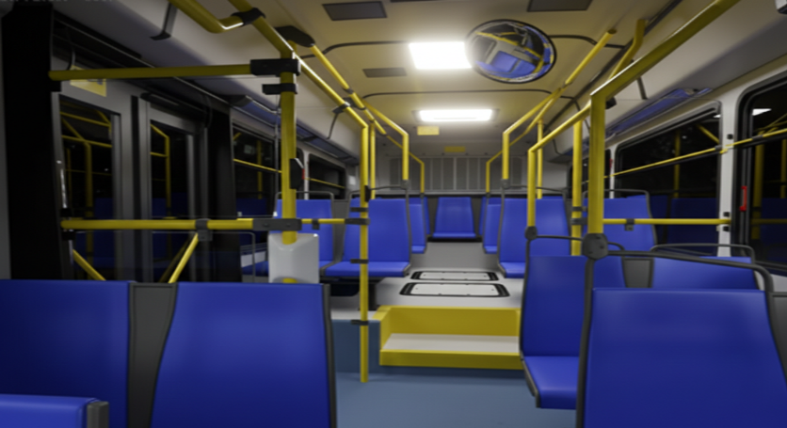
Assignment B2
Implement lighting on your previous assignment or project.
Your scene should have multiple point lights, directional light, spot light (with single cut-off angle)and emissive light.
Use keys 1 to turn on and off directional light, 2 for point lights , 3 for spot light respectively.
Use keys 5, 6 and 7 to turn on and off ambient light, diffuse light and specular light respectively.
Implement your own version of glm:: lookAt function.
Divide the viewport in 4 equal parts and control the scene of each viewport with input user input. For example:
Print the controls and key actions on console.
Combine Lighting | Ambient Only
Diffusive Only | Directional Only
Isometric View | Top View
Front View | Inside View

